Slide 1
Python API Homework - What's the Weather Like?
Whether financial, political, or social -- data's true power lies in its ability to answer questions definitively. So let's take what you've learned about Python requests, APIs, and JSON traversals to answer a fundamental question: "What's the weather like as we approach the equator?"

Slide 2
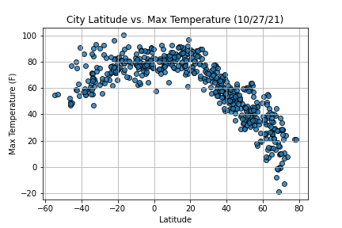
Latitude vs Max Temp on 10/27/2021

Slide 3
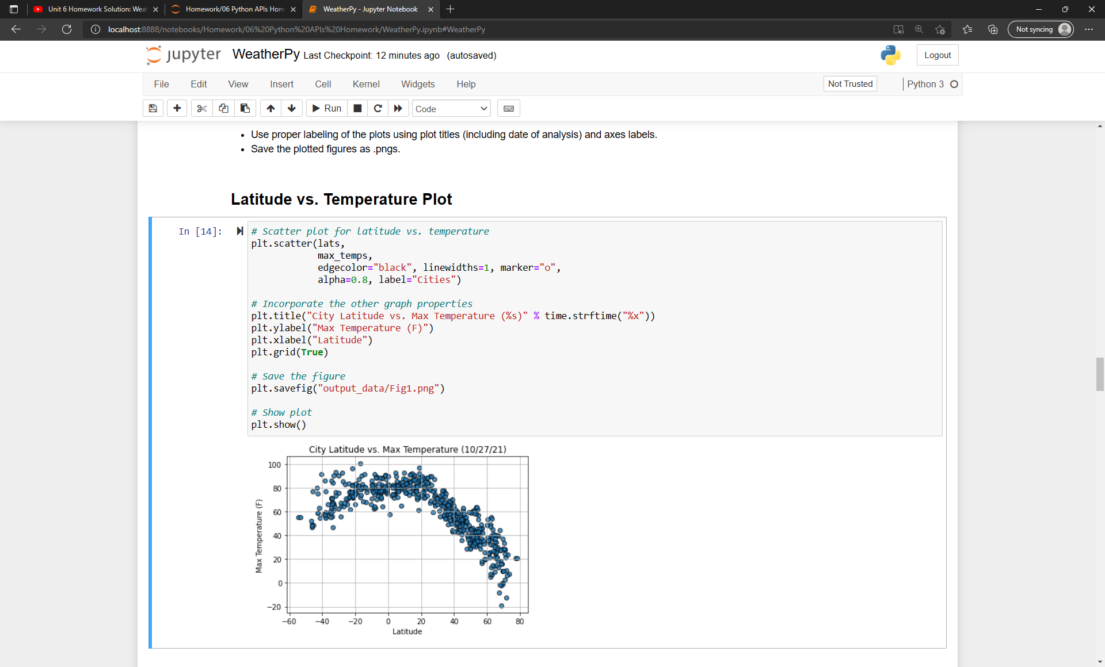
Latitude vs Temperature Coding

Slide 4
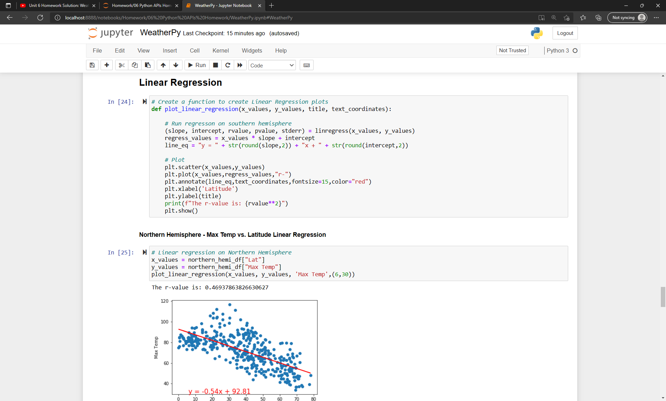
Northern Hemisphere - Max Temp vs. Latitude Linear Regression

Slide 5
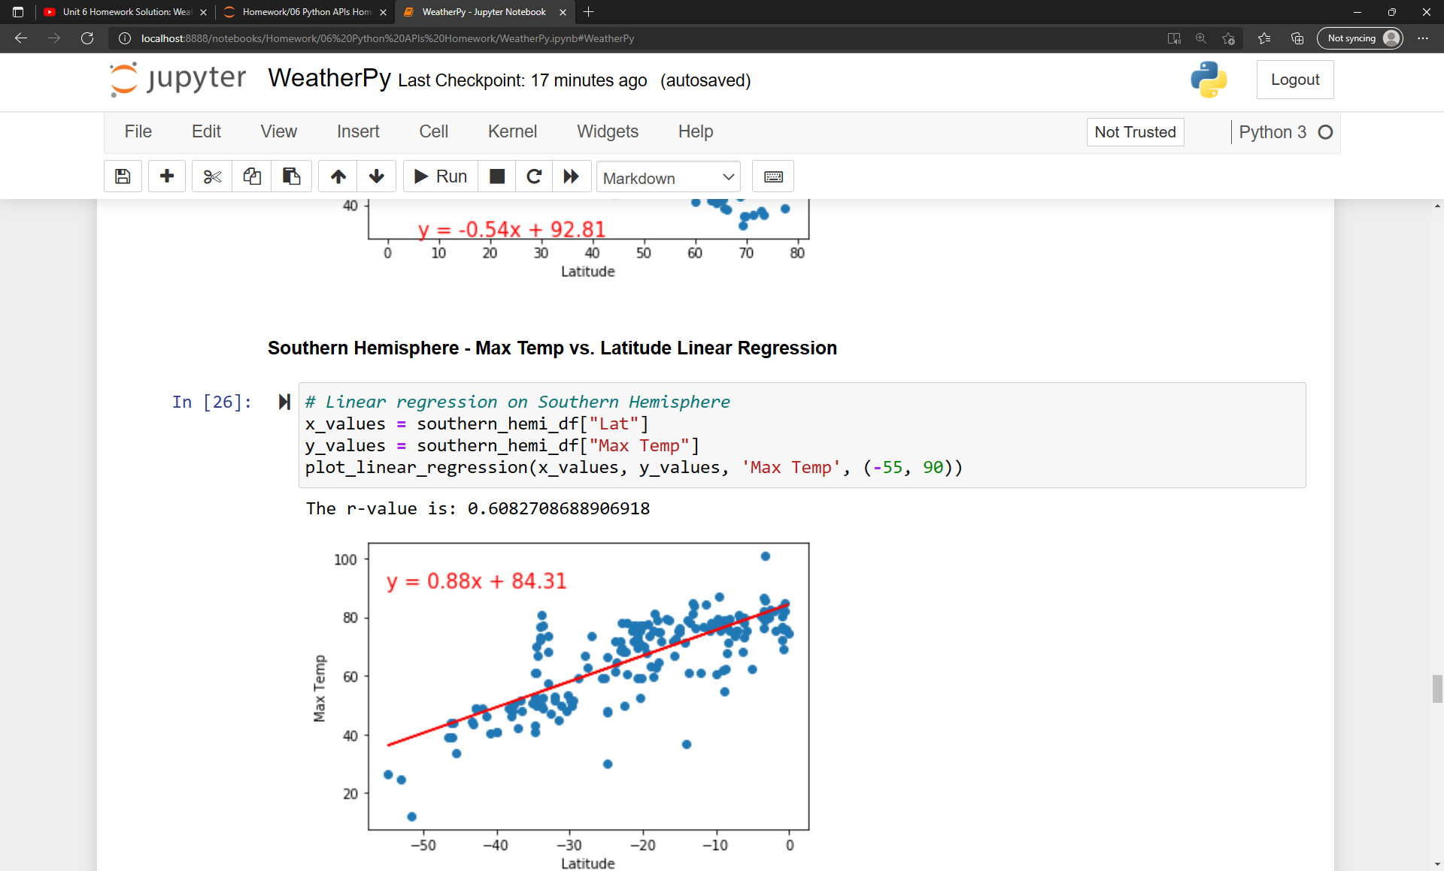
Southern Hemisphere - Max Temp vs. Latitude Linear Regression

Slide 6
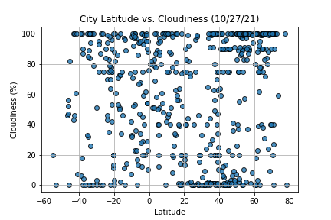
Latitude vs Cloudiness on 10/27/2021

Slide 7
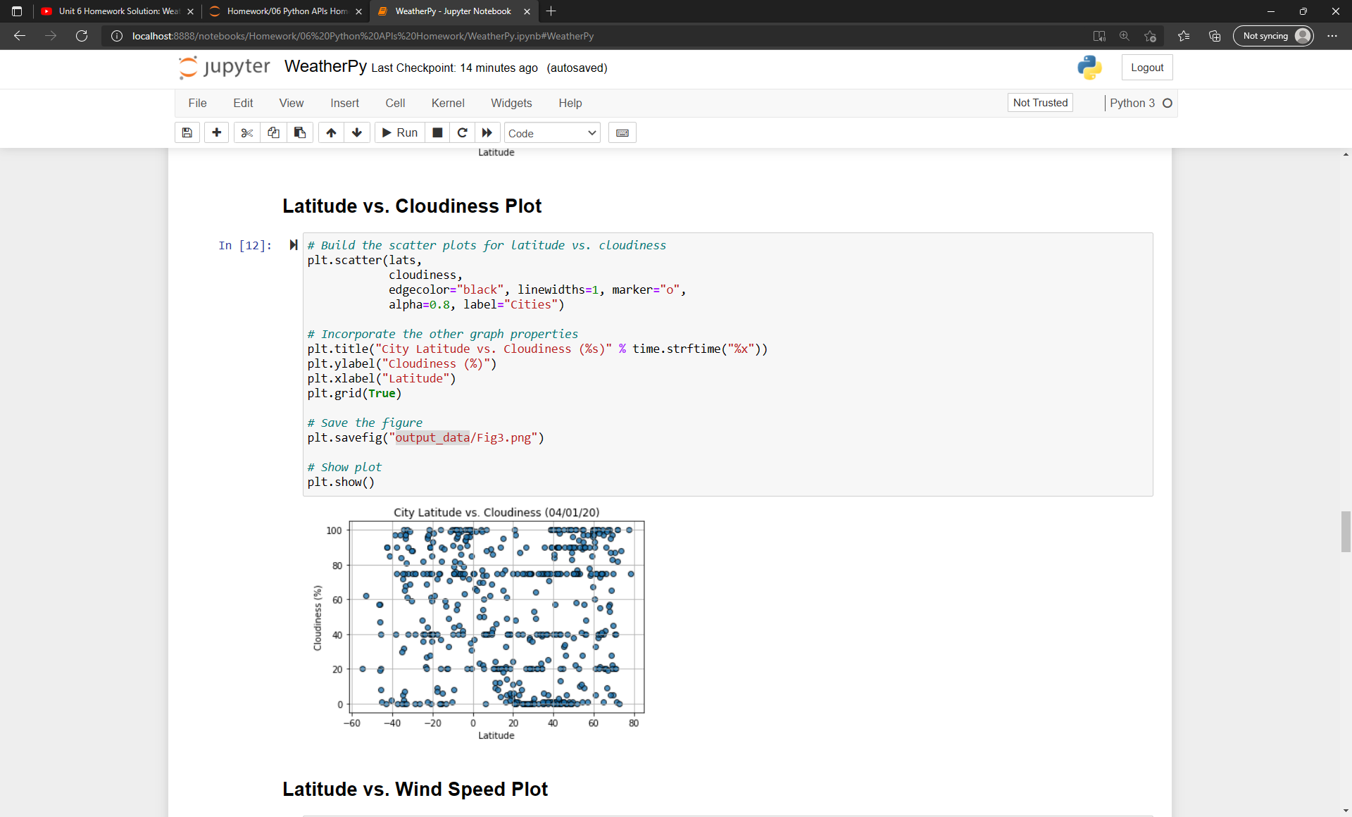
Latitude vs Cloudiness Coding

Slide 8
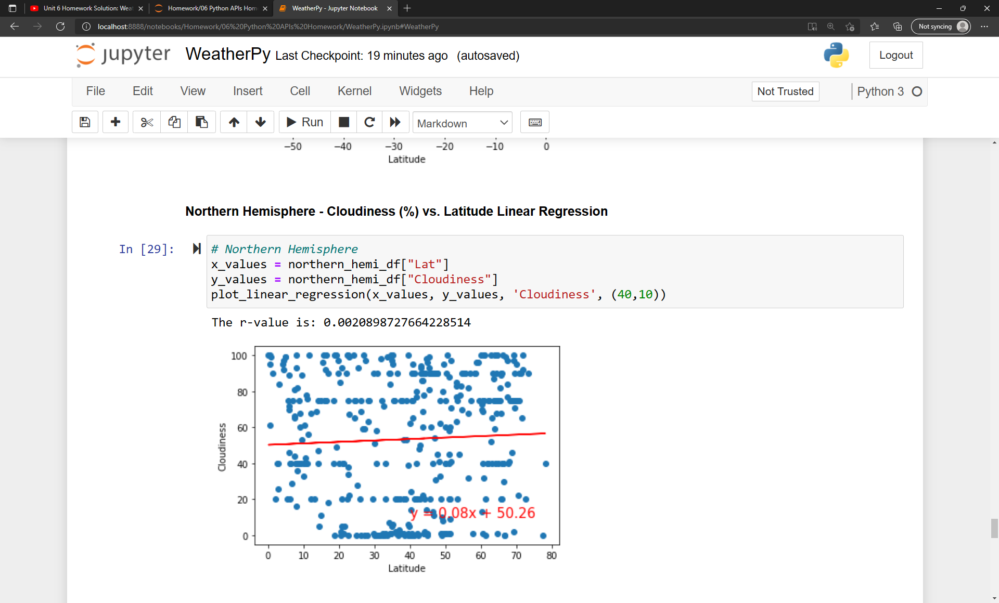
Northern Hemisphere - Cloudiness (%) vs. Latitude Linear Regression

Slide 9
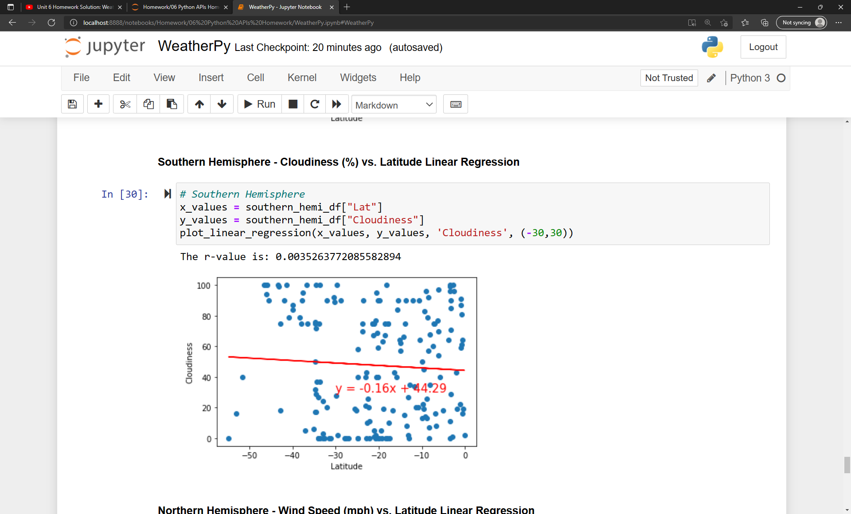
Southern Hemisphere - Cloudiness (%) vs. Latitude Linear Regression

Slide 10
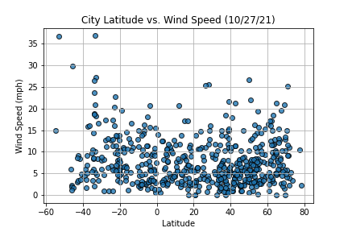
Latitude vs Wind Speed on 10/27/2021

Slide 11
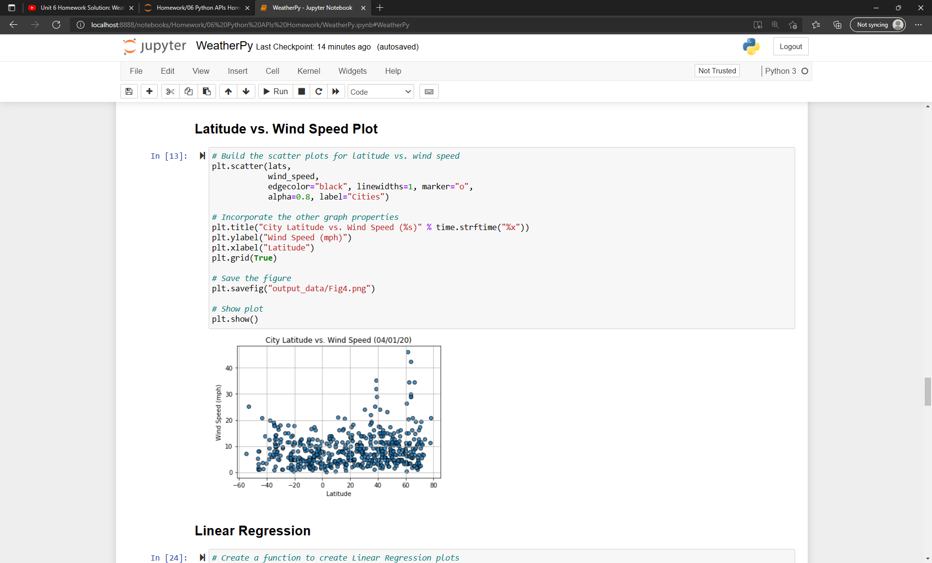
Latitude vs Wind Speed Plot

Slide 12
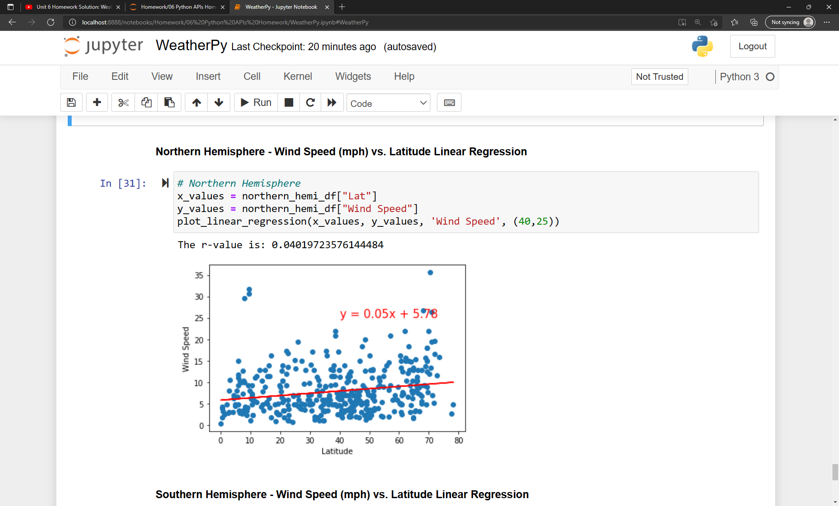
Northern Hemisphere – Wind Speed (MPH) vs. Latitude Linear Regression

Slide 13
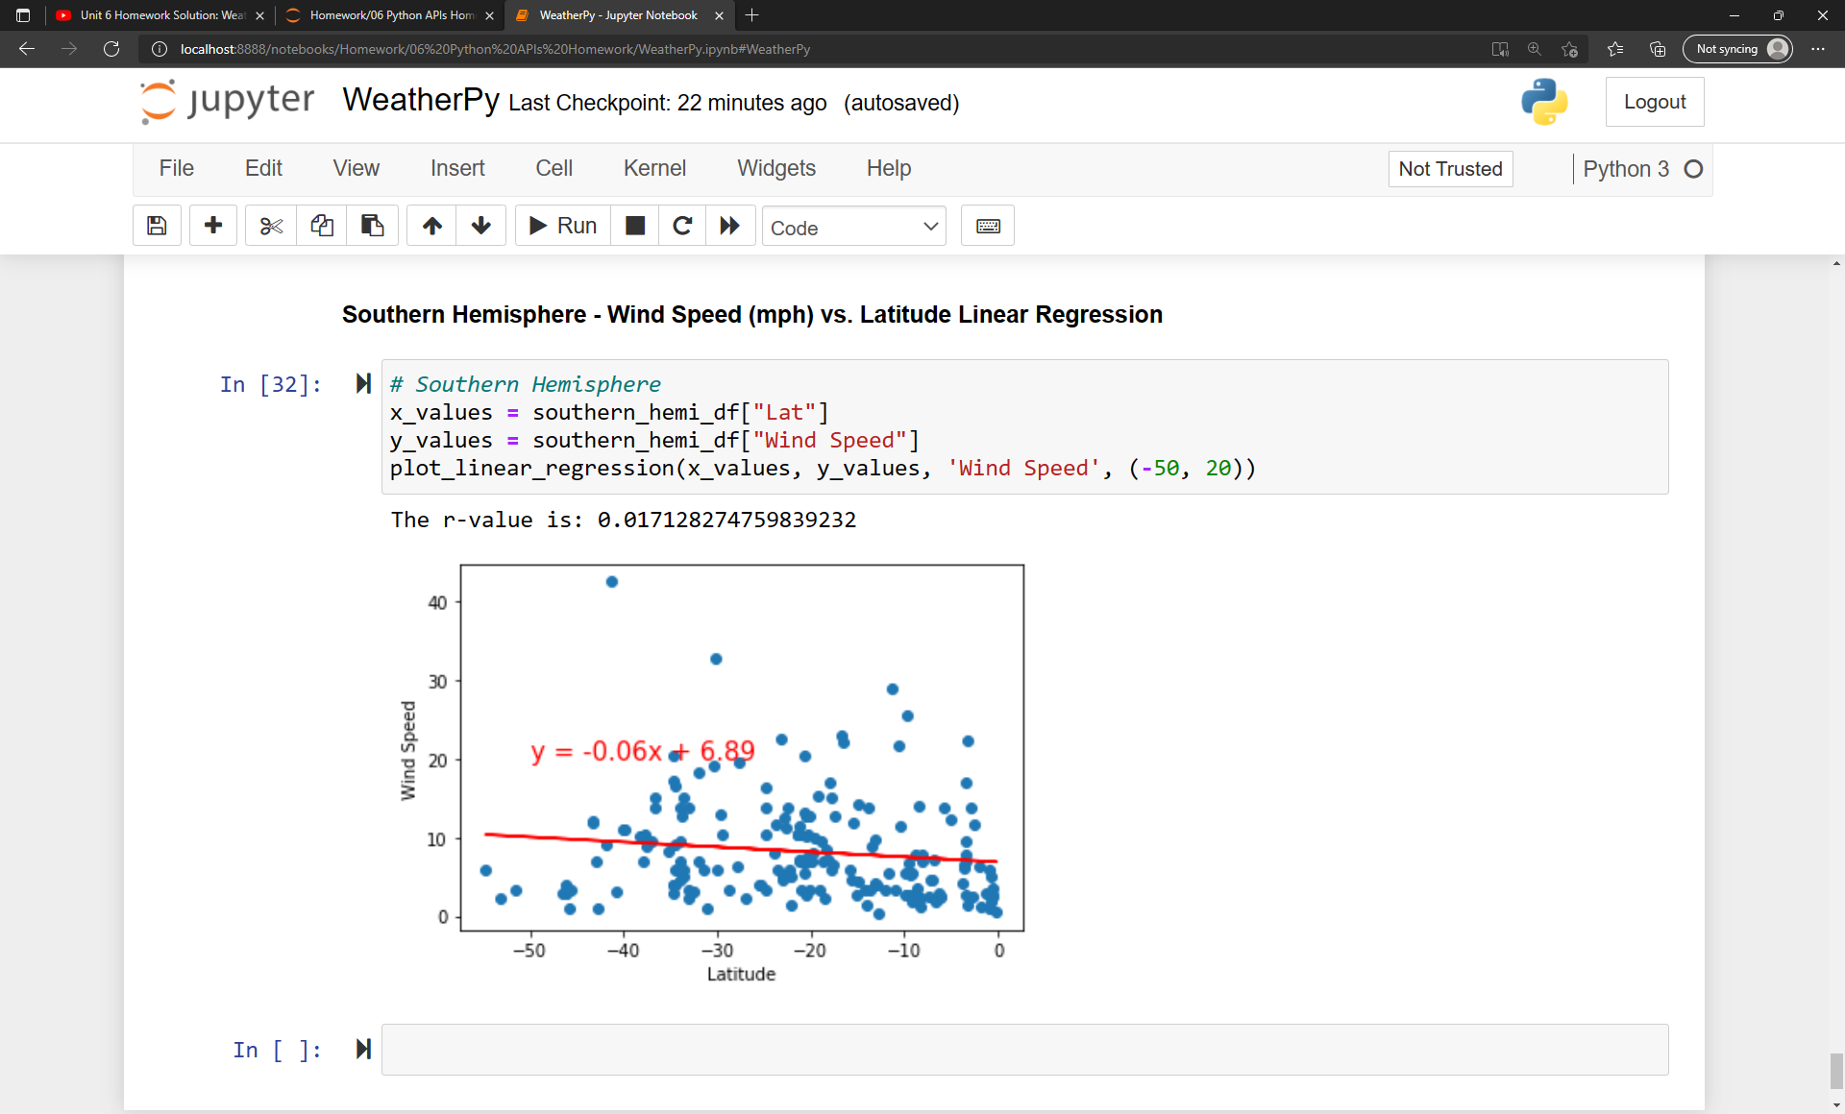
Southern Hemisphere – Wind Speed (MPH) vs. Latitude Linear Regression

Slide 14
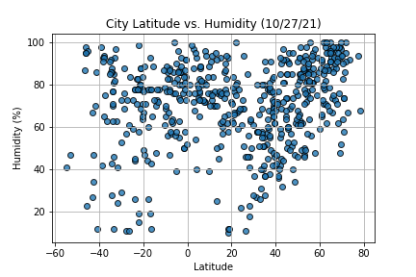
Latitude vs Humitity on 10/27/2021

Slide 15
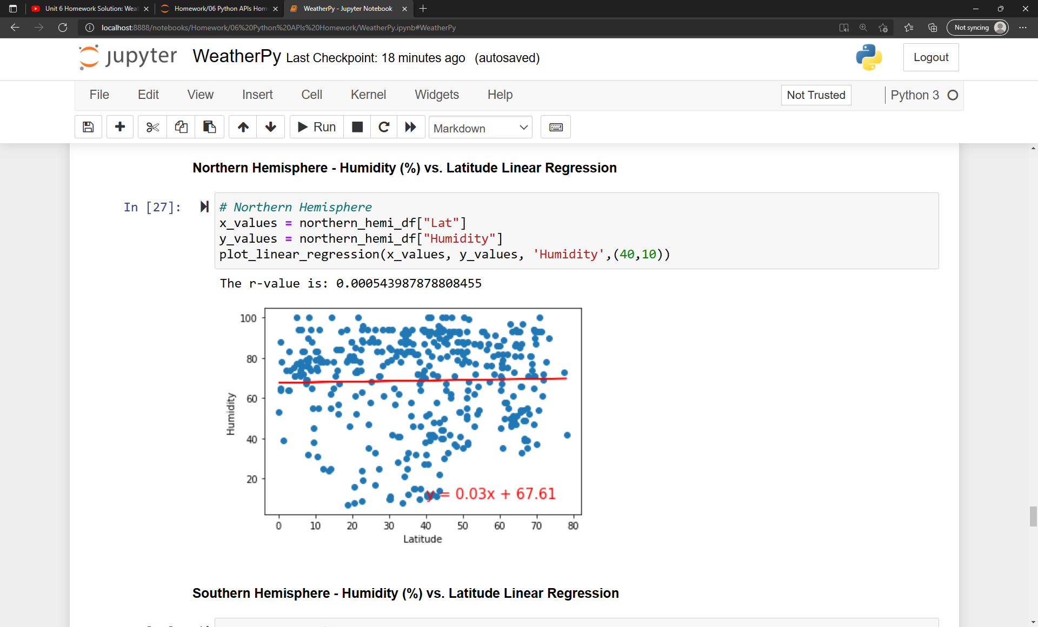
Northern Hemisphere - Humidity (%) vs. Latitude Linear Regression

Slide 16
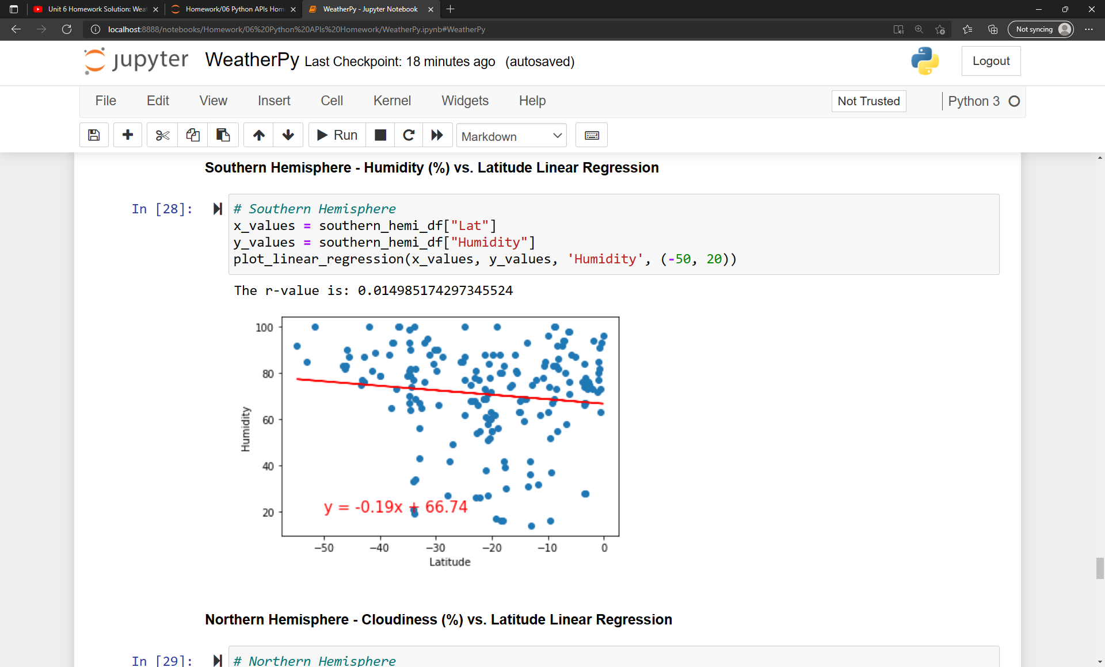
Southern Hemisphere - Humidity (%) vs. Latitude Linear Regression

